Slide 1
Constraint Satisfaction Problems
PRESENTED BY
R.PAVITHRA

Slide 2
DEFINTION
A constraint satisfaction problem (CSP) is a problem that requires its solution within some limitations or conditions also known as constraints
It consists of the following:
A finite set of variables which stores the solution (V = {V1, V2, V3,....., Vn})
A set of discrete values known as domain from which the solution is picked (D = {D1, D2, D3,.....,Dn})
A finite set of constraints (C = {C1, C2, C3,......, Cn})

Slide 3
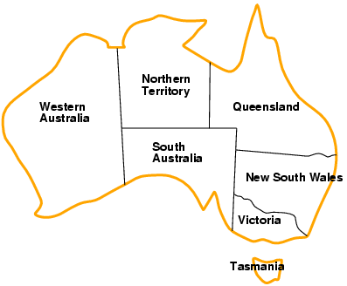
Example: Map-Coloring
Variables WA, NT, Q, NSW, V, SA, T
Domains D_{i} = {red,green,blue}
Constraints: adjacent regions must have different colors e.g., WA ≠ NT, or (WA,NT) in {(red,green),(red,blue),(green,red), (green,blue),(blue,red),(blue,green)}

Slide 4
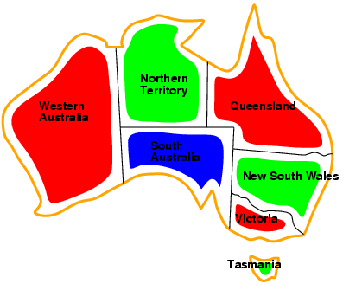
Example: Map-Coloring
Solutions are complete and consistent assignments
e.g., WA = red, NT = green, Q = red, NSW = green,V = red,SA = blue,T = green

Slide 5
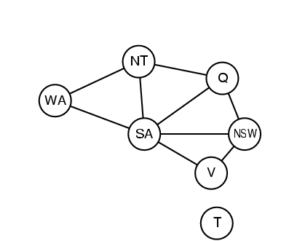
Constraint graph
Binary CSP: each constraint relates two variables
Constraint graph: nodes are variables, arcs are constraints

Slide 6
Backtracking
Backtracking is used to solve problems in which a sequence of objects is chosen from a specified set so that the sequence satisfies some criterion.
Backtracking is a modified depth-first search of a tree.
It is the procedure whereby, after determining that a node can lead to nothing but dead nodes, we go back (“backtrack”) to the node’s parent and proceed with the search on the next child.

Slide 7
Backtrack Algorithm
Based on depth-first recursive search
Approach
Tests whether solution has been found
If found solution, return it
Else for each choice that can be made
Make that choice
Recursive
If recursion returns a solution, return it
If no choices remain, return failure
Some times called “search tree”

Slide 8
Improving Backtracking
Search pruning will help us to reduce the search space and hence get a solution faster.
The idea is to avoid those paths that may not lead to a solutions as early as possible by finding contradictions so that we can backtrack immediately without the need to build a hopeless solution vector.

Slide 9
Backtracking examples
The backtracking can be used in this cases:
Solving a maze
Coloring a map
Solving a puzzle
N queens problem etc.,

Slide 10
Backtracking EXAMPLE—8 Queens Problem
The 8-queens problem is a classical combinatorial problem in which it is required to place eight queens on an 8 x 8 chessboard so no two can attack each other.
A queen can attack another queen if it exists in the same row, column or diagonal as the queen.

Slide 11
Backtracking EXAMPLE—8 Queens Problem(cont…)
This problem can be solved by trying to place the first queen, then the second queen so that it cannot attack the first, and then the third so that it is not conflicting with previously placed queens.

Slide 12
Backtracking EXAMPLE—8 Queens Problem(cont…)
It is an empty 8 x 8 chess board. We have to place the queens in this board.

Slide 13
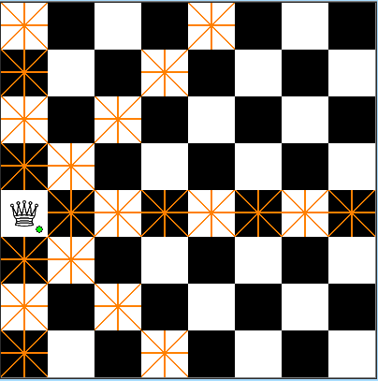
Backtracking EXAMPLE—8 Queens Problem(cont…)
We have placed the first queen on the chess board

Slide 14
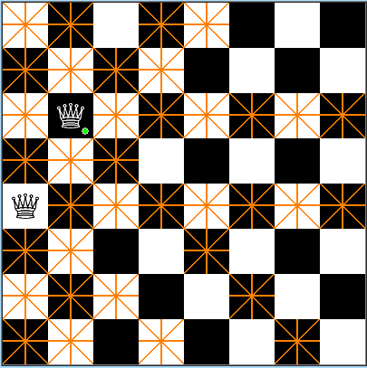
Backtracking EXAMPLE—8 Queens Problem(cont…)
Then we have placed the second queen on the board.
The darken place should not have the queens because they are horizontal, vertical, diagonal to the placed queens.

Slide 15
Backtracking EXAMPLE—8 Queens Problem(cont…)
We have placed the third queen on board.

Slide 16
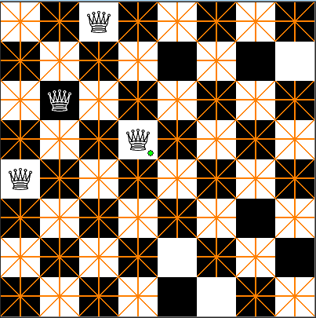
Backtracking EXAMPLE—8 Queens Problem(cont…)
We have placed the 4th queen on the board.
We have placed that in the wrong spot, so we backtrack and change the place of that one.

Slide 17
Backtracking EXAMPLE—8 Queens Problem(cont…)
In this way, we have to continue the process untill our is reached ie., we must place 8 queens on the board.

Slide 18
Backtracking EXAMPLE—8 Queens Problem(cont…)
Backtracking provides the hope to solve some problem instances of nontrivial sizes by pruning non-promising branches of the state-space tree.
The success of backtracking varies from problem to problem and from instance to instance.
Backtracking possibly generates all possible candidates in an exponentially growing state-space tree.

Slide 19
THANK YOU

